Slide 1
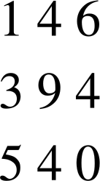
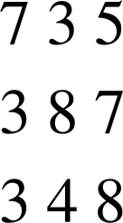
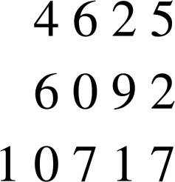
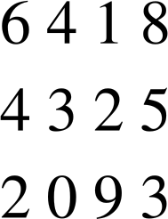


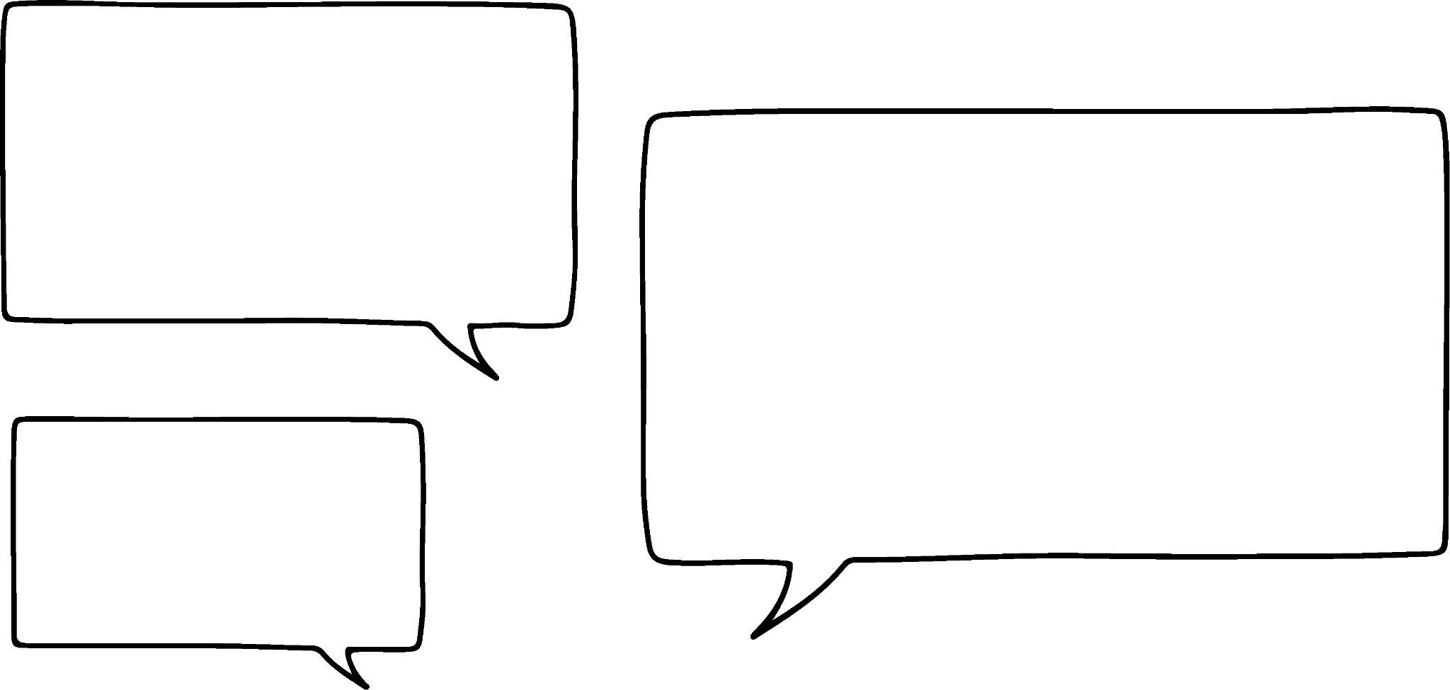

Checking understanding of arithmetic procedures with integers and decimals
Task A: Arithmetic procedures with integers
Find the missing digits in each of the following:
a)
b)
c)
d)
+
−
+
−
2) Calculate the following, without a calculator. Try to use the efficient methods we have talked about.
580 × 5
87 × 4
26 × 8
45 × 6
485 ÷ 5
Task B: Addition and subtraction of decimals
Sofia and Andeep record how far they kick a football.
What is the total distance?
Much much further did Sofia kick the ball?
I kicked it 12.73 metres.
I kicked it 9.8 metres.

Slide 2




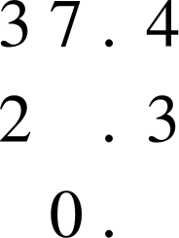
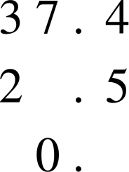
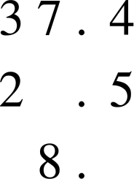
Checking understanding of arithmetic procedures with integers and decimals
2) Lucas, Aisha and Jun record how long they can bounce a basketball for.
What is the total time?
How much longer did Lucas manage than Jun?
I did 35.6 seconds.
And, I managed
27.87 seconds.
I did 28.45 seconds.
3) Here are three slightly different subtractions.
a)
b)
c)
−
−
−
Without calculating, explain why the following statements are false.
The digit in the must be 1 in each calculation as the tenths digits are one apart.
The digit in the must be 7 in both cases as the difference is 0.
The digit in the must be 1 in all three calculations as 3 − 2 = 1. Find the missing digits.

Slide 3

Checking understanding of arithmetic procedures with integers and decimals
Task C: Multiplication and division of decimals
Match the operation on the left to its equivalent on the right.
× 5
× 2 × 2 × 2
÷ 4
÷ 2 ÷ 2
× 8
÷ 2 ÷ 3
÷ 5
× 10 ÷ 2
÷ 6
× 2 × 3
× 6
÷ 10 × 2
£4.75
2) Find the cost of the following:
2 boxes
10 boxes
5 boxes
6 boxes
3) The Oak students decide to buy one box of chocolates between them.
Work out how much each person pays if:
2 students buy the box
4 students buy the box
5 students buy the box
£5.80
Mathematics in Education and Industry
v2.1

